Slide 1
Noise in Analog Modulation
Gaurav S. Kasbekar
Dept. of Electrical Engineering
IIT Bombay

Slide 2
Introduction
Recall: we studied amplitude modulation (AM) and frequency modulation (FM) from a deterministic perspective
Now we analyze the effects of noise on the performance of AM and FM systems
For this analysis, we model noise as additive, white and Gaussian (AWGN)
Above analysis also allows us to compare noise performances of different modulation-demodulation schemes

Slide 3
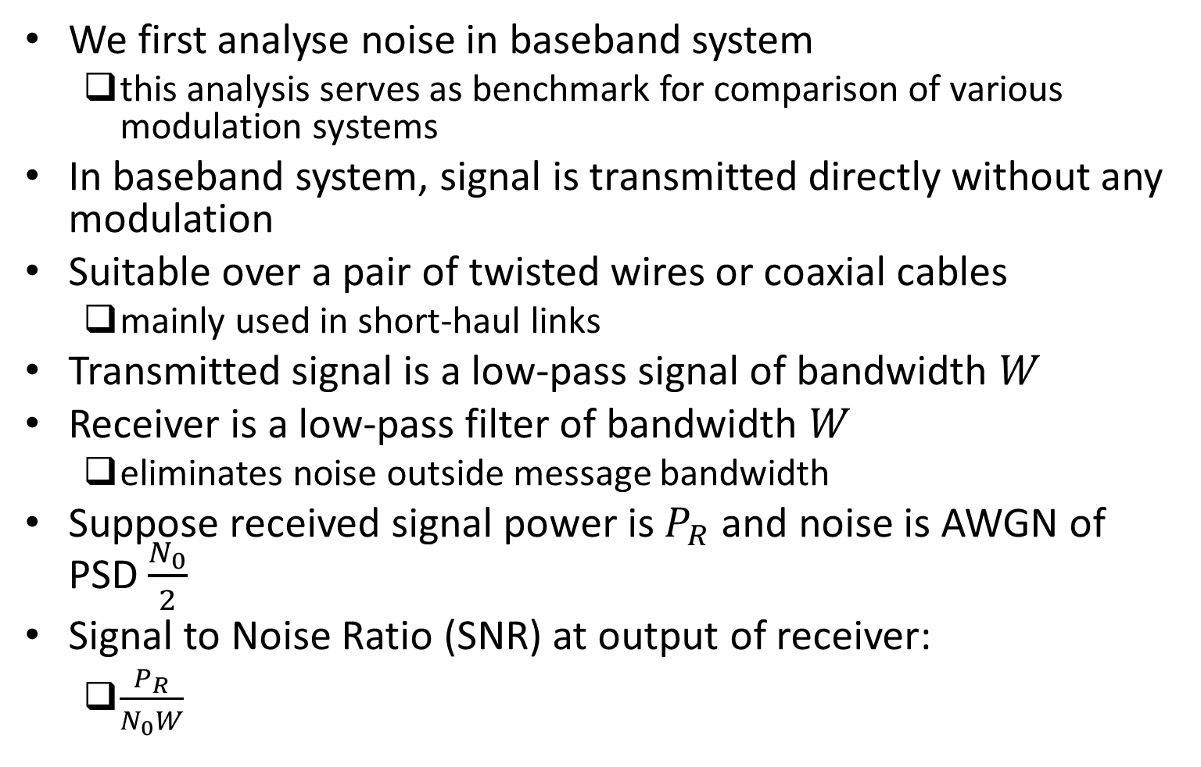
Effect of Noise on Baseband System
We first analyse noise in baseband system
this analysis serves as benchmark for comparison of various modulation systems
In baseband system, signal is transmitted directly without any modulation
Suitable over a pair of twisted wires or coaxial cables
mainly used in short-haul links
Transmitted signal is a low-pass signal of bandwidth $W$
Receiver is a low-pass filter of bandwidth $W$
eliminates noise outside message bandwidth
Suppose received signal power is $P_{R}$ and noise is AWGN of PSD $\frac{N_{0}}{2}$
Signal to Noise Ratio (SNR) at output of receiver:
$\frac{P_{R}}{N_{0}W}$

Slide 4
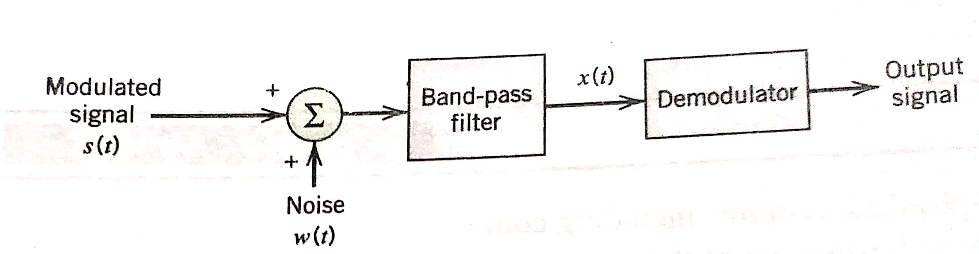
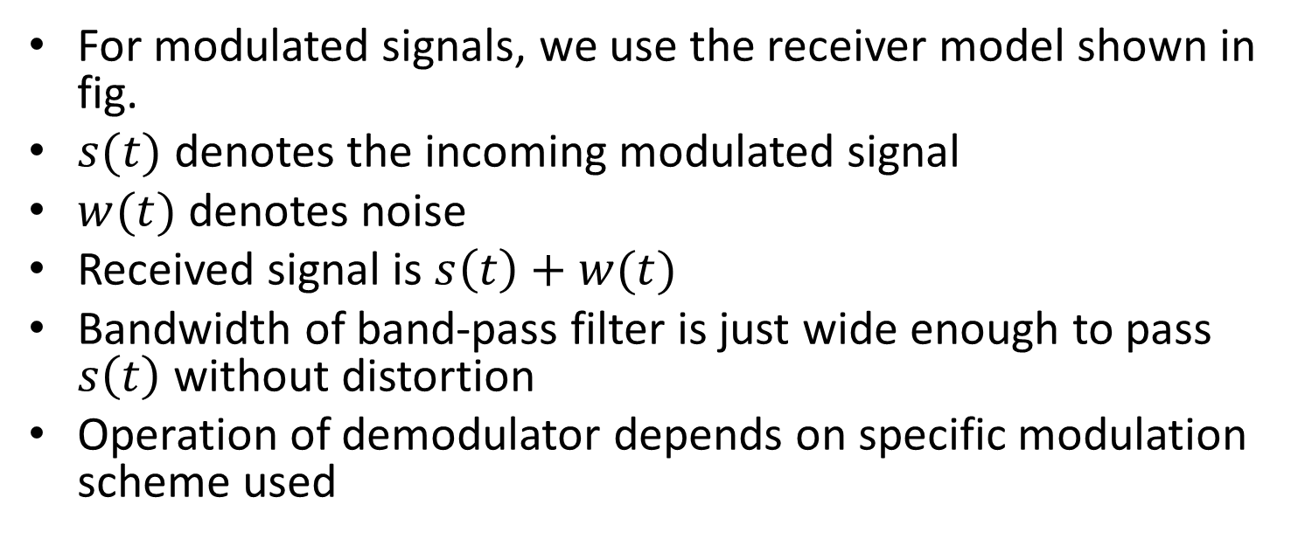
Receiver Model for Modulation Systems
For modulated signals, we use the receiver model shown in fig.
$s(t)$ denotes the incoming modulated signal
$w(t)$ denotes noise
Received signal is $s\left(t\right)+w(t)$
Bandwidth of band-pass filter is just wide enough to pass $s\left(t\right)$ without distortion
Operation of demodulator depends on specific modulation scheme used
Ref: “Communication Systems” by Haykin and Moher, 5th edition

Slide 5
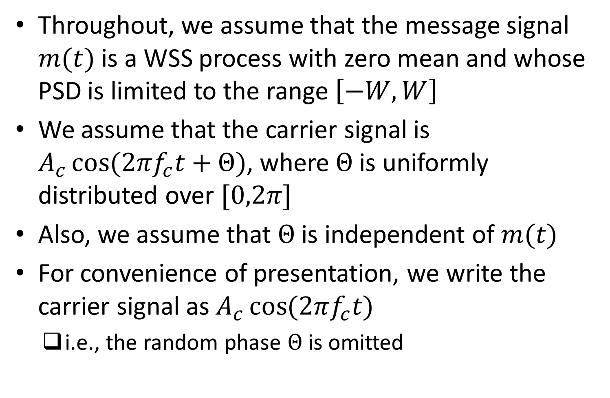
Assumptions
Throughout, we assume that the message signal $m(t)$ is a WSS process with zero mean and whose PSD is limited to the range $\left[−W,W\right]$
We assume that the carrier signal is $A_{c}\cos{(2πf_{c}t+Θ)}$, where $Θ$ is uniformly distributed over $[0,2π]$
Also, we assume that $Θ$ is independent of $m(t)$
For convenience of presentation, we write the carrier signal as $A_{c}\cos{(2πf_{c}t)}$
i.e., the random phase $Θ$ is omitted

Slide 6
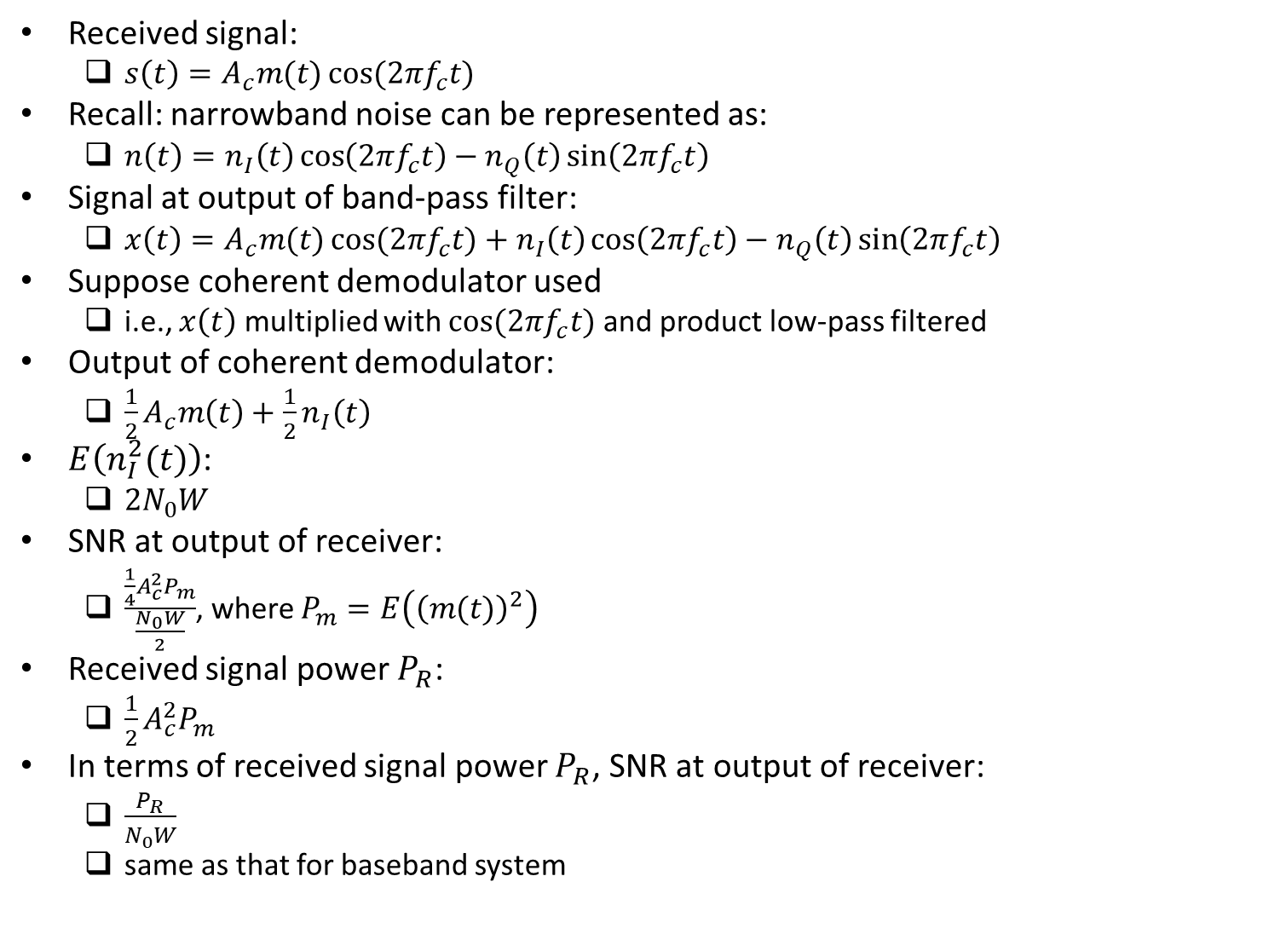
Effect of Noise on DSB-SC System
Received signal:
$s\left(t\right)=A_{c}m(t)\cos{(2πf_{c}t)}$
Recall: narrowband noise can be represented as:
$n\left(t\right)=n_{I}\left(t\right)\cos\left(2πf_{c}t\right)−n_{Q}\left(t\right)\sin\left(2πf_{c}t\right)$
Signal at output of band-pass filter:
${x\left(t\right)=A}_{c}m(t)\cos{(2πf_{c}t)}+n_{I}\left(t\right)\cos\left(2πf_{c}t\right)−n_{Q}\left(t\right)\sin\left(2πf_{c}t\right)$
Suppose coherent demodulator used
i.e., $x\left(t\right)$ multiplied with $\cos{(2πf_{c}t)}$ and product low-pass filtered
Output of coherent demodulator:
$\frac{1}{2}A_{c}m\left(t\right)+\frac{1}{2}n_{I}\left(t\right)$
$E\left(n_{I}^{2}(t)\right)$:
$2N_{0}W$
SNR at output of receiver:
$\frac{\frac{1}{4}A_{c}^{2}P_{m}}{\frac{N_{0}W}{2}}$, where $P_{m}=E\left({\left(m(t)\right)}^{2}\right)$
Received signal power $P_{R}$:
$\frac{1}{2}A_{c}^{2}P_{m}$
In terms of received signal power $P_{R}$, SNR at output of receiver:
$\frac{P_{R}}{N_{0}W}$
same as that for baseband system

Slide 7
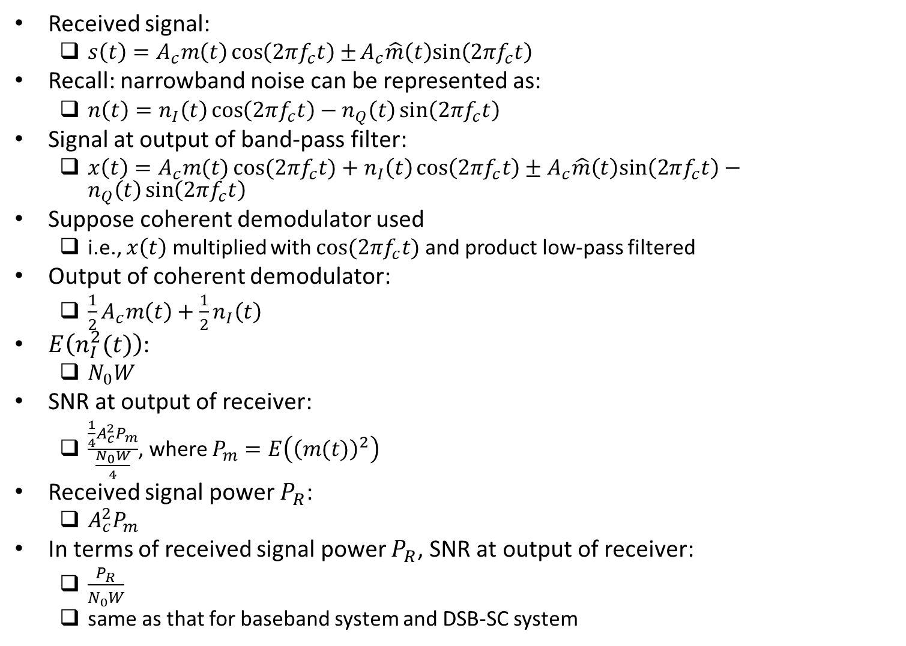
Effect of Noise on SSB-SC System
Received signal:
$s\left(t\right)=A_{c}m\left(t\right)\cos\left(2πf_{c}t\right)±A_{c}\hat{m}\left(t\right)sin\left(2πf_{c}t\right)⁡$
Recall: narrowband noise can be represented as:
$n\left(t\right)=n_{I}\left(t\right)\cos\left(2πf_{c}t\right)−n_{Q}\left(t\right)\sin\left(2πf_{c}t\right)$
Signal at output of band-pass filter:
${x\left(t\right)=A}_{c}m(t)\cos{(2πf_{c}t)}+n_{I}\left(t\right)\cos\left(2πf_{c}t\right)±A_{c}\hat{m}\left(t\right)sin\left(2πf_{c}t\right)−n_{Q}\left(t\right)\sin\left(2πf_{c}t\right)$
Suppose coherent demodulator used
i.e., $x\left(t\right)$ multiplied with $\cos{(2πf_{c}t)}$ and product low-pass filtered
Output of coherent demodulator:
$\frac{1}{2}A_{c}m\left(t\right)+\frac{1}{2}n_{I}\left(t\right)$
$E\left(n_{I}^{2}(t)\right)$:
$N_{0}W$
SNR at output of receiver:
$\frac{\frac{1}{4}A_{c}^{2}P_{m}}{\frac{N_{0}W}{4}}$, where $P_{m}=E\left({\left(m(t)\right)}^{2}\right)$
Received signal power $P_{R}$:
$A_{c}^{2}P_{m}$
In terms of received signal power $P_{R}$, SNR at output of receiver:
$\frac{P_{R}}{N_{0}W}$
same as that for baseband system and DSB-SC system

Slide 8
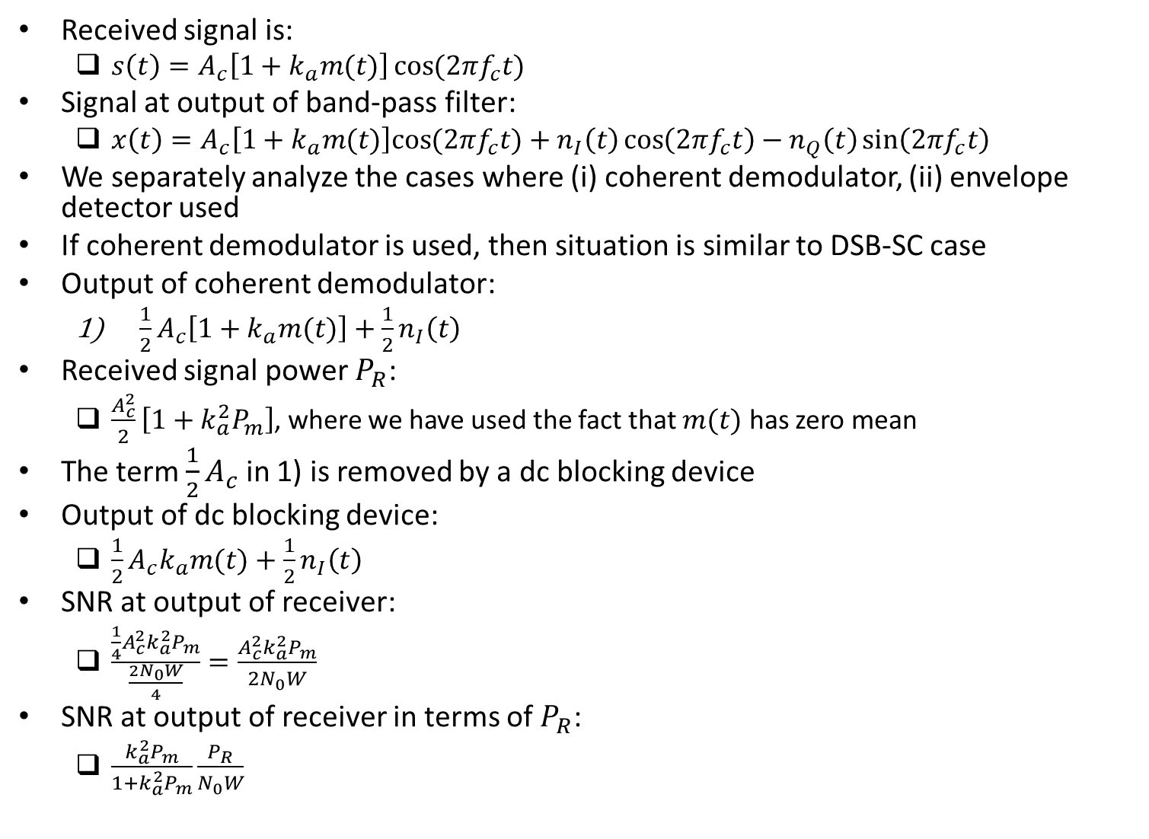
Effect of Noise on AM System
Received signal is:
$s\left(t\right)=A_{c}\left[1+k_{a}m(t)\right]\cos{(2πf_{c}t)}$
Signal at output of band-pass filter:
$x\left(t\right)=A_{c}\left[1+k_{a}m(t)\right]cos{(2πf_{c}t)}+n_{I}\left(t\right)\cos\left(2πf_{c}t\right)−n_{Q}\left(t\right)\sin\left(2πf_{c}t\right)$
We separately analyze the cases where (i) coherent demodulator, (ii) envelope detector used
If coherent demodulator is used, then situation is similar to DSB-SC case
Output of coherent demodulator:
$\frac{1}{2}A_{c}\left[1+k_{a}m(t)\right]+\frac{1}{2}n_{I}\left(t\right)$
Received signal power $P_{R}$:
$\frac{A_{c}^{2}}{2}\left[1+k_{a}^{2}P_{m}\right]$, where we have used the fact that $m(t)$ has zero mean
The term $\frac{1}{2}A_{c}$ in 1) is removed by a dc blocking device
Output of dc blocking device:
$\frac{1}{2}A_{c}k_{a}m(t)+\frac{1}{2}n_{I}\left(t\right)$
SNR at output of receiver:
$\frac{\frac{1}{4}A_{c}^{2}{k_{a}^{2}P}_{m}}{\frac{2N_{0}W}{4}}=\frac{A_{c}^{2}k_{a}^{2}P_{m}}{2N_{0}W}$
SNR at output of receiver in terms of $P_{R}$:
$\frac{k_{a}^{2}P_{m}}{1+k_{a}^{2}P_{m}}\frac{P_{R}}{N_{0}W}$

Slide 9
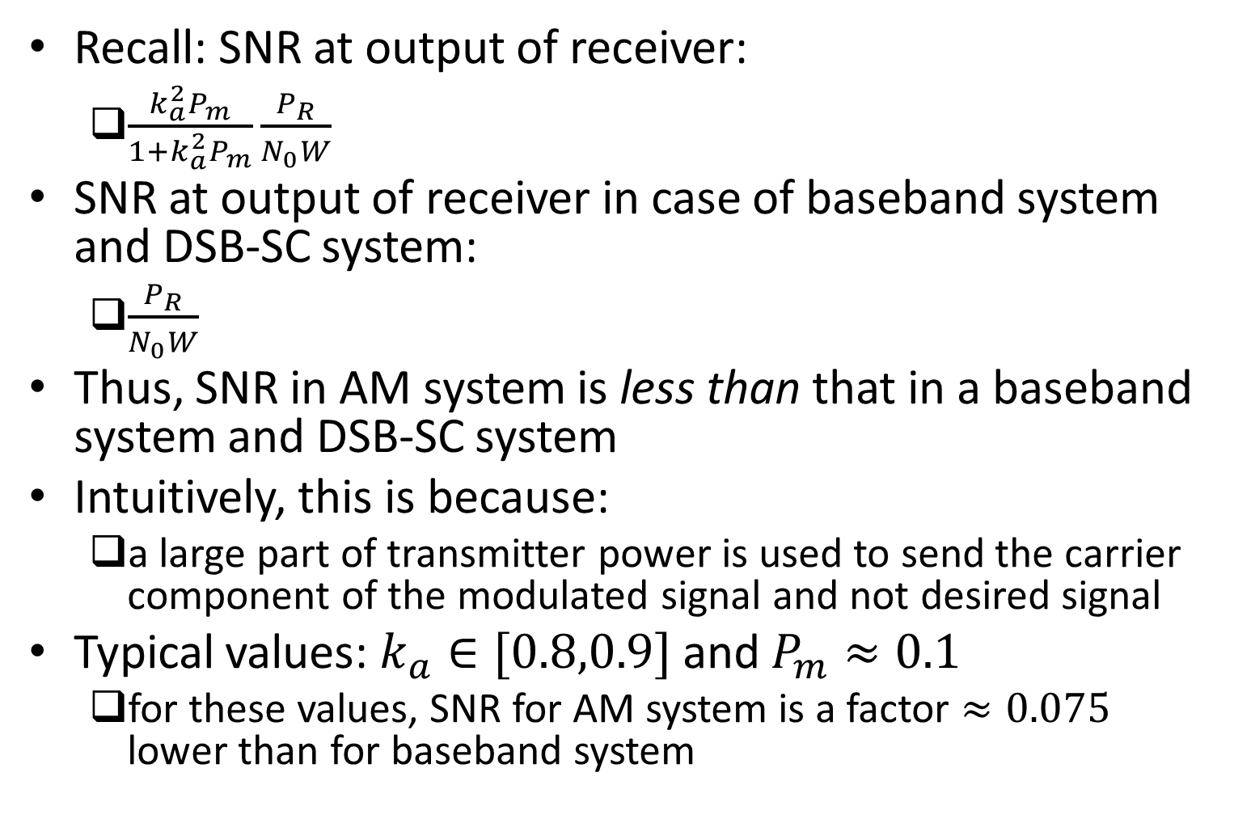
Effect of Noise on AM System (contd.)
Recall: SNR at output of receiver:
$\frac{k_{a}^{2}P_{m}}{1+k_{a}^{2}P_{m}}\frac{P_{R}}{N_{0}W}$
SNR at output of receiver in case of baseband system and DSB-SC system:
$\frac{P_{R}}{N_{0}W}$
Thus, SNR in AM system is less than that in a baseband system and DSB-SC system
Intuitively, this is because:
a large part of transmitter power is used to send the carrier component of the modulated signal and not desired signal
Typical values: $k_{a}∈[0.8,0.9]$ and $P_{m}≈0.1$
for these values, SNR for AM system is a factor $≈0.075$ lower than for baseband system

Slide 10
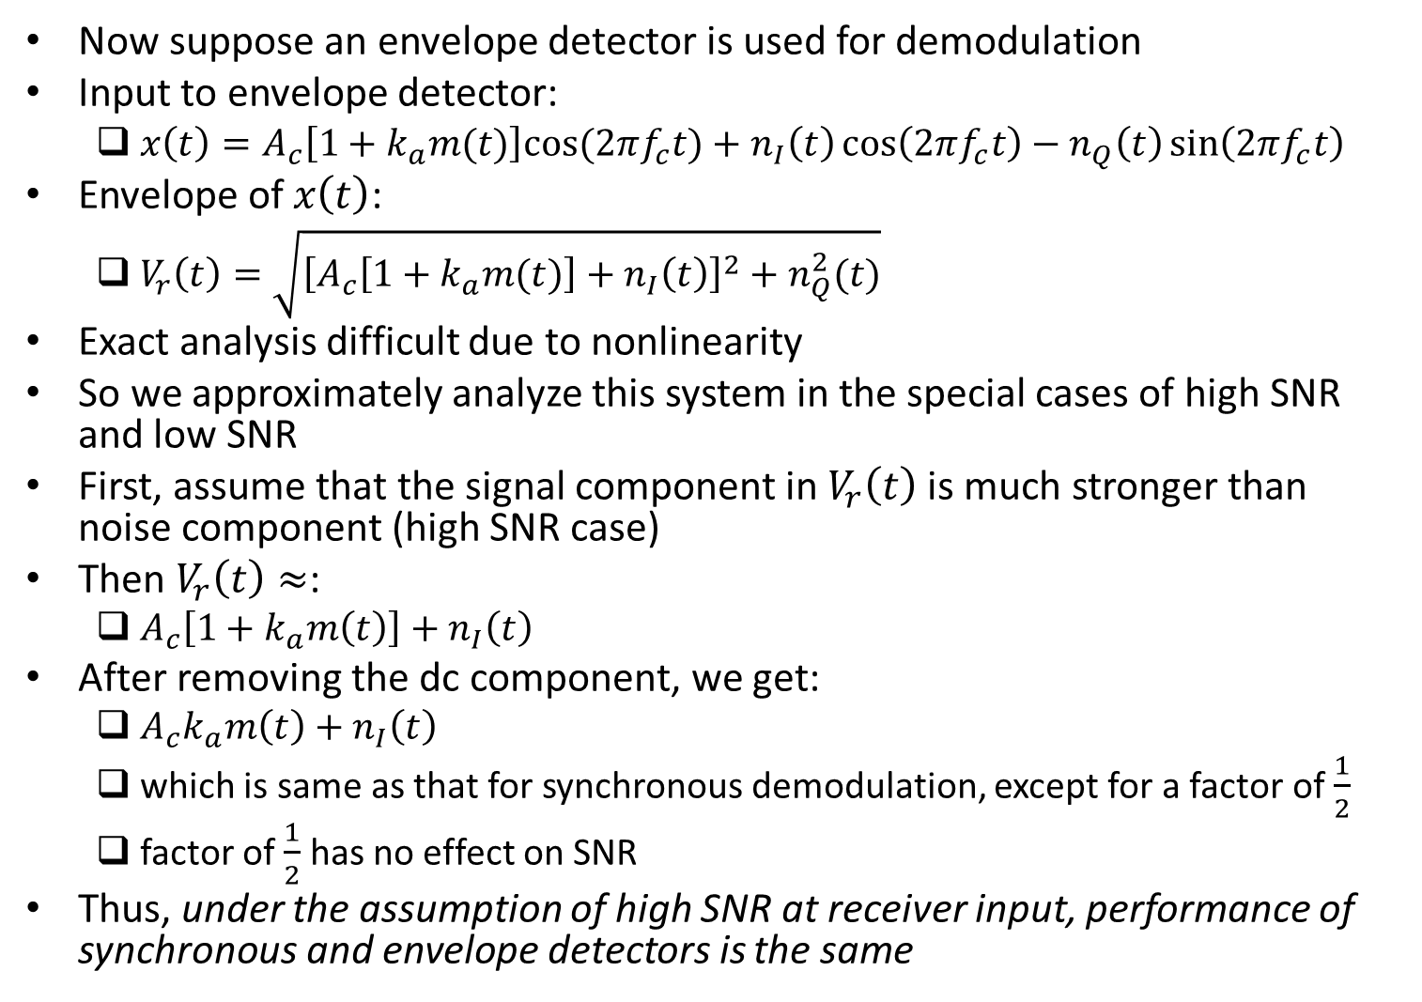
Effect of Noise on AM System (contd.)
Now suppose an envelope detector is used for demodulation
Input to envelope detector:
$x\left(t\right)=A_{c}\left[1+k_{a}m(t)\right]cos{(2πf_{c}t)}+n_{I}\left(t\right)\cos\left(2πf_{c}t\right)−n_{Q}\left(t\right)\sin\left(2πf_{c}t\right)$
Envelope of $x\left(t\right)$:
$V_{r}\left(t\right)=\sqrt{{\left[A_{c}\left[1+k_{a}m(t)\right]+n_{I}\left(t\right)\right]}^{2}+n_{Q}^{2}(t)}$
Exact analysis difficult due to nonlinearity
So we approximately analyze this system in the special cases of high SNR and low SNR
First, assume that the signal component in $V_{r}\left(t\right)$ is much stronger than noise component (high SNR case)
Then $V_{r}\left(t\right)≈$:
$A_{c}\left[1+k_{a}m\left(t\right)\right]+n_{I}\left(t\right)$
After removing the dc component, we get:
$A_{c}k_{a}m\left(t\right)+n_{I}\left(t\right)$
which is same as that for synchronous demodulation, except for a factor of $\frac{1}{2}$
factor of $\frac{1}{2}$ has no effect on SNR
Thus, under the assumption of high SNR at receiver input, performance of synchronous and envelope detectors is the same

Slide 11
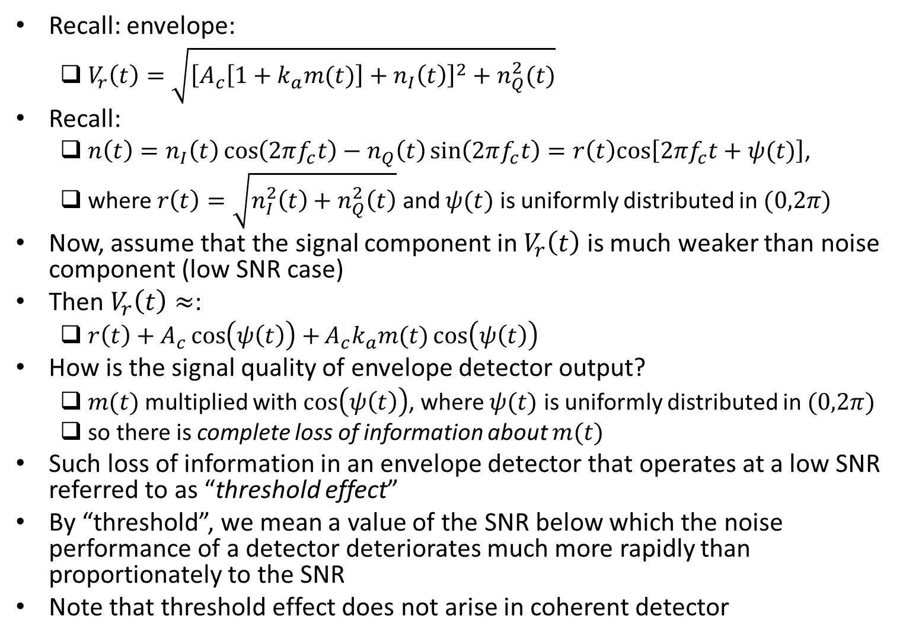
Effect of Noise on AM System (contd.)
Recall: envelope:
$V_{r}\left(t\right)=\sqrt{{\left[A_{c}\left[1+k_{a}m(t)\right]+n_{I}\left(t\right)\right]}^{2}+n_{Q}^{2}(t)}$
Recall:
$n\left(t\right)=n_{I}\left(t\right)\cos\left(2πf_{c}t\right)−n_{Q}\left(t\right)\sin\left(2πf_{c}t\right)=r\left(t\right)cos\left[2πf_{c}t+ψ(t)\right]$,
where $r\left(t\right)=\sqrt{n_{I}^{2}\left(t\right)+n_{Q}^{2}\left(t\right)}$ and $ψ(t)$ is uniformly distributed in $(0,2π)$
Now, assume that the signal component in $V_{r}\left(t\right)$ is much weaker than noise component (low SNR case)
Then $V_{r}\left(t\right)≈$:
$r\left(t\right)+A_{c}\cos\left(ψ\left(t\right)\right)+A_{c}k_{a}m(t)\cos\left(ψ\left(t\right)\right)$
How is the signal quality of envelope detector output?
$m(t)$ multiplied with $\cos\left(ψ\left(t\right)\right)$, where $ψ(t)$ is uniformly distributed in $(0,2π)$
so there is complete loss of information about $m(t)$
Such loss of information in an envelope detector that operates at a low SNR referred to as “threshold effect”
By “threshold”, we mean a value of the SNR below which the noise performance of a detector deteriorates much more rapidly than proportionately to the SNR
Note that threshold effect does not arise in coherent detector

Slide 12
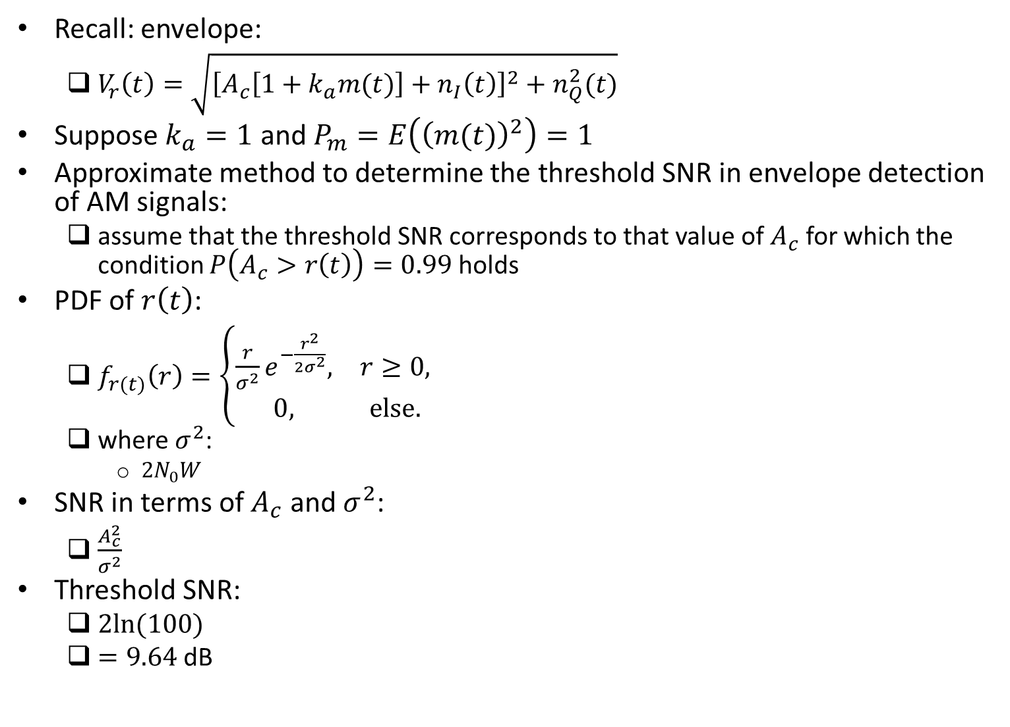
Example
Recall: envelope:
$V_{r}\left(t\right)=\sqrt{{\left[A_{c}\left[1+k_{a}m(t)\right]+n_{I}\left(t\right)\right]}^{2}+n_{Q}^{2}(t)}$
Suppose $k_{a}=1$ and $P_{m}=E\left({\left(m(t)\right)}^{2}\right)=1$
Approximate method to determine the threshold SNR in envelope detection of AM signals:
assume that the threshold SNR corresponds to that value of $A_{c}$ for which the condition $P\left(A_{c}>r\left(t\right)\right)=0.99$ holds
PDF of $r\left(t\right)$:
$f_{r(t)}\left(r\right)=\left\{\begin{matrix}\frac{r}{σ^{2}}e^{−\frac{r^{2}}{2σ^{2}}}, & r≥0, \\ 0, & else.\end{matrix}\right.$
where $σ^{2}$:
$2N_{0}W$
SNR in terms of $A_{c}$ and $σ^{2}$:
$\frac{A_{c}^{2}}{σ^{2}}$
Threshold SNR:
$2ln⁡(100)$
$=9.64$ dB

Slide 13
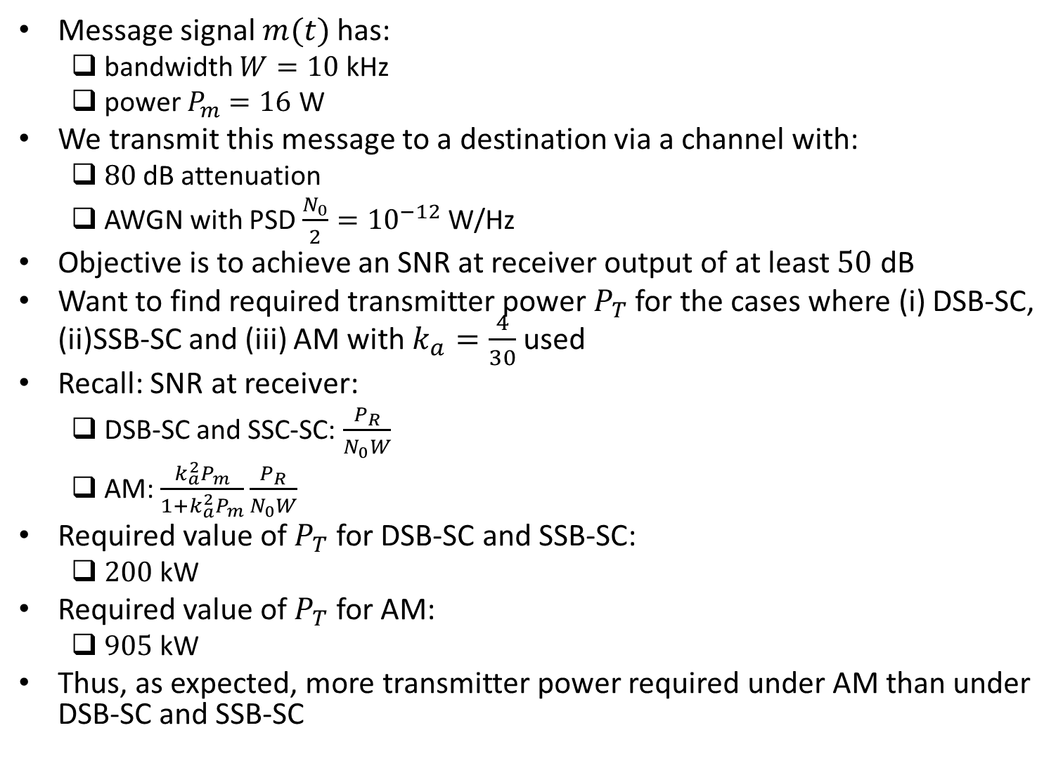
Example
Message signal $m(t)$ has:
bandwidth $W=10$ kHz
power $P_{m}=16$ W
We transmit this message to a destination via a channel with:
$80$ dB attenuation
AWGN with PSD $\frac{N_{0}}{2}={10}^{−12}$ W/Hz
Objective is to achieve an SNR at receiver output of at least $50$ dB
Want to find required transmitter power $P_{T}$ for the cases where (i) DSB-SC, (ii)SSB-SC and (iii) AM with $k_{a}=\frac{4}{30}$ used
Recall: SNR at receiver:
DSB-SC and SSC-SC: $\frac{P_{R}}{N_{0}W}$
AM: $\frac{k_{a}^{2}P_{m}}{1+k_{a}^{2}P_{m}}\frac{P_{R}}{N_{0}W}$
Required value of $P_{T}$ for DSB-SC and SSB-SC:
$200$ kW
Required value of $P_{T}$ for AM:
$905$ kW
Thus, as expected, more transmitter power required under AM than under DSB-SC and SSB-SC

Slide 14
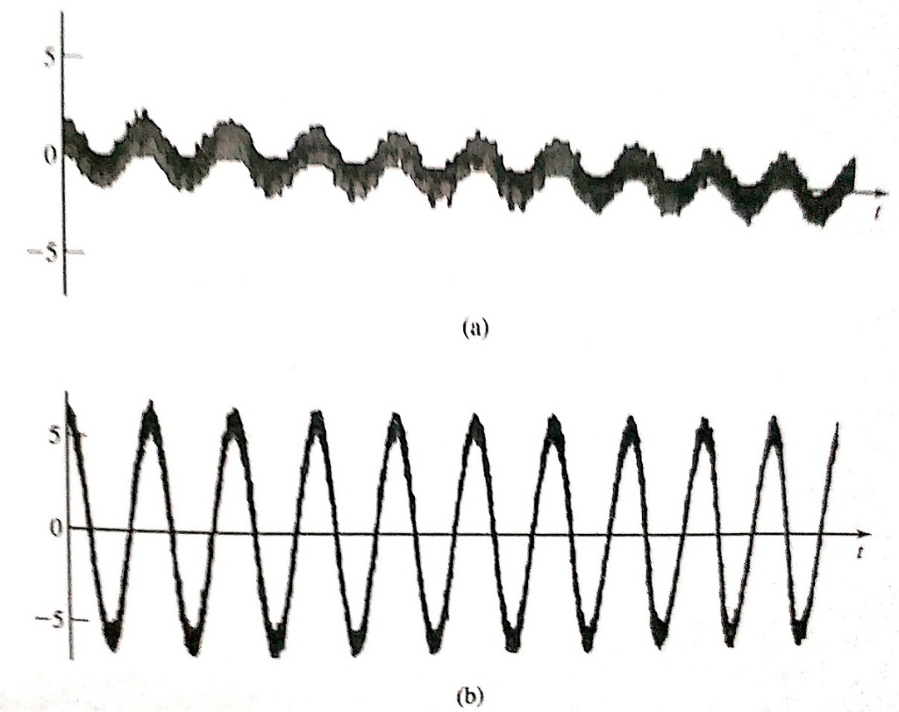
Effect of Noise on FM System
We now:
study the performance of FM signals when contaminated by AWGN and
compare it with that of AM signals
Recall: in AM, message information is contained in amplitude of modulated signal
so noise, being additive, is directly added to message information
However, in FM, message information is contained in frequency (zero-crossings) of modulated signal
but noise is added to amplitude
so message is contaminated by noise to the extent that added noise changes the frequency (zero-crossings) of modulated signal
Fig. shows FM signal with added noise in the cases of low-power and high-power FM signals
From above discussion and fig., intuitively, we expect:
Effect of noise on FM system less than that on AM system
Effect of noise on high-power FM system less than that on low-power FM system
Following analysis confirms this intuition
Ref: “Communication Systems Engineering” by Proakis and Salehi

Slide 15
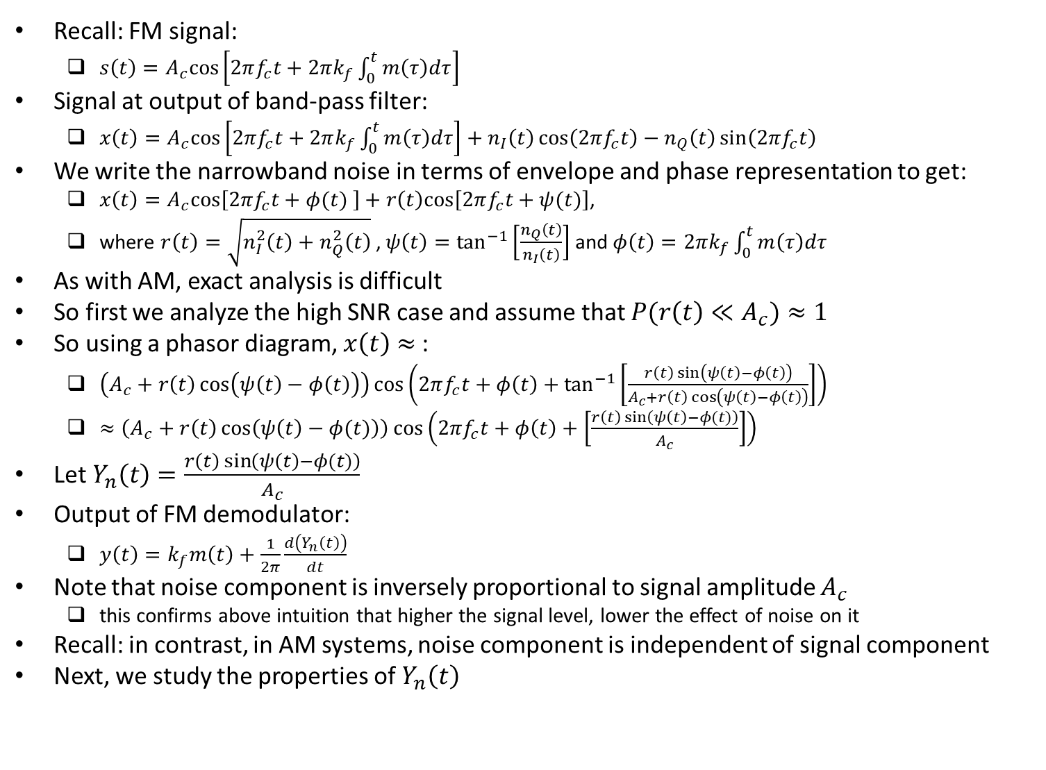
Effect of Noise on FM System (contd.)
Recall: FM signal:
$s\left(t\right)=A_{c}cos\left[2πf_{c}t+2πk_{f}\int_{0}^{t}{m\left(τ\right)dτ}\right]$
Signal at output of band-pass filter:
$x\left(t\right)=A_{c}cos\left[2πf_{c}t+2πk_{f}\int_{0}^{t}{m\left(τ\right)dτ}\right]+n_{I}\left(t\right)\cos\left(2πf_{c}t\right)−n_{Q}\left(t\right)\sin\left(2πf_{c}t\right)$
We write the narrowband noise in terms of envelope and phase representation to get:
$x\left(t\right)=A_{c}cos\left[2πf_{c}t+φ(t) \right]+r\left(t\right)cos\left[2πf_{c}t+ψ(t)\right]$,
where $r\left(t\right)=\sqrt{n_{I}^{2}\left(t\right)+n_{Q}^{2}\left(t\right)}$ , $ψ\left(t\right)=\tan^{−1}\left[\frac{n_{Q}\left(t\right)}{n_{I}\left(t\right)}\right]$ and $φ\left(t\right)=2πk_{f}\int_{0}^{t}{m\left(τ\right)dτ}$
As with AM, exact analysis is difficult
So first we analyze the high SNR case and assume that $P(r\left(t\right)≪A_{c})≈1$
So using a phasor diagram, $x\left(t\right)$ $≈$:
$\left(A_{c}+r\left(t\right)\cos\left(ψ\left(t\right)−φ\left(t\right)\right)\right)\cos\left(2πf_{c}t+φ\left(t\right)+\tan^{−1}\left[\frac{r\left(t\right)\sin\left(ψ\left(t\right)−φ\left(t\right)\right)}{A_{c}+r\left(t\right)\cos\left(ψ\left(t\right)−φ\left(t\right)\right)}\right]\right)$
$≈\left(A_{c}+r\left(t\right)\cos\left(ψ\left(t\right)−φ(t)\right)\right)\cos\left(2πf_{c}t+φ\left(t\right)+\left[\frac{r\left(t\right)\sin\left(ψ\left(t\right)−φ(t)\right)}{A_{c}}\right]\right)$
Let $Y_{n}\left(t\right)=\frac{r\left(t\right)\sin\left(ψ\left(t\right)−φ(t)\right)}{A_{c}}$
Output of FM demodulator:
$y\left(t\right)=k_{f}m\left(t\right)+\frac{1}{2π}\frac{d\left(Y_{n}\left(t\right)\right)}{dt}$
Note that noise component is inversely proportional to signal amplitude $A_{c}$
this confirms above intuition that higher the signal level, lower the effect of noise on it
Recall: in contrast, in AM systems, noise component is independent of signal component
Next, we study the properties of $Y_{n}\left(t\right)$

Slide 16
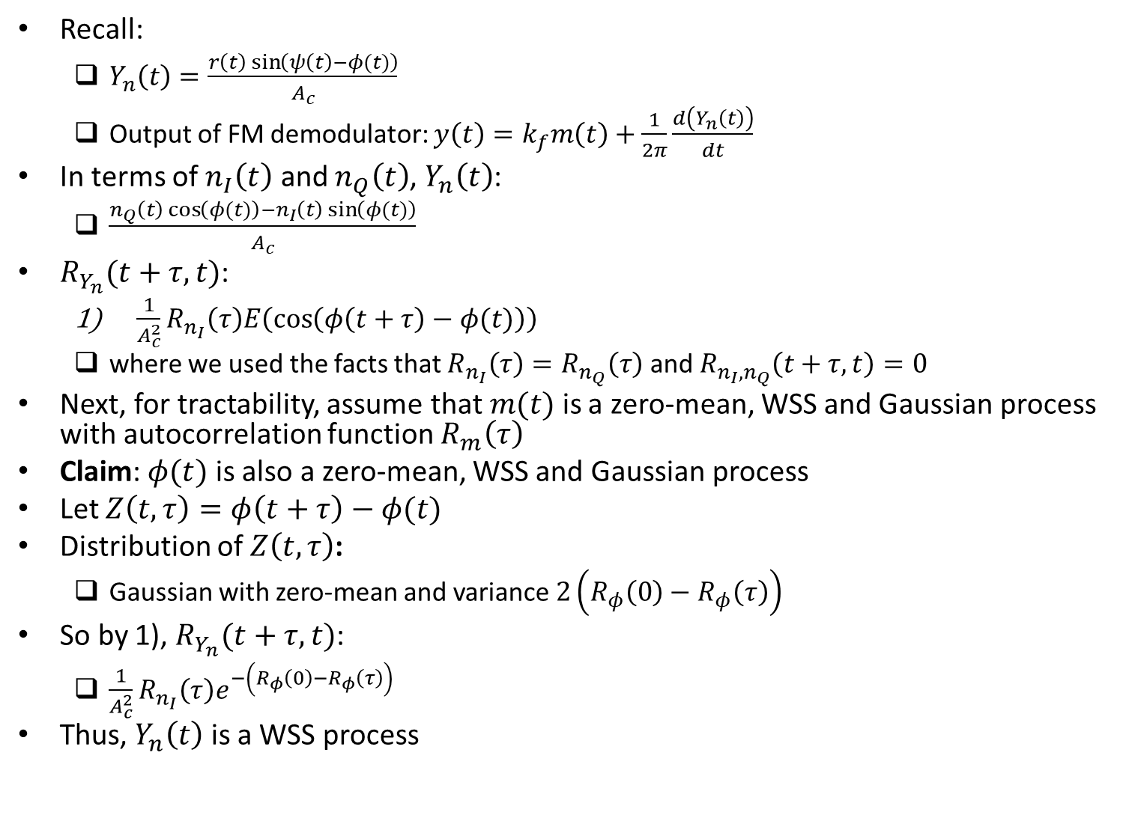
Effect of Noise on FM System (contd.)
Recall:
$Y_{n}\left(t\right)=\frac{r\left(t\right)\sin\left(ψ\left(t\right)−φ(t)\right)}{A_{c}}$
Output of FM demodulator: $y\left(t\right)=k_{f}m\left(t\right)+\frac{1}{2π}\frac{d\left(Y_{n}\left(t\right)\right)}{dt}$
In terms of $n_{I}\left(t\right)$ and $n_{Q}\left(t\right)$, $Y_{n}\left(t\right)$:
$\frac{n_{Q}\left(t\right)\cos\left(φ(t)\right)−n_{I}\left(t\right)\sin\left(φ(t)\right)}{A_{c}}$
$R_{Y_{n}}(t+τ,t)$:
$\frac{1}{A_{c}^{2}}R_{n_{I}}\left(τ\right)E\left(\cos\left(φ\left(t+τ\right)−φ(t)\right)\right)$
where we used the facts that $R_{n_{I}}\left(τ\right)=R_{n_{Q}}\left(τ\right)$ and $R_{n_{I},n_{Q}}\left(t+τ,t\right)=0$
Next, for tractability, assume that $m(t)$ is a zero-mean, WSS and Gaussian process with autocorrelation function $R_{m}\left(τ\right)$
Claim: $φ(t)$ is also a zero-mean, WSS and Gaussian process
Let $Z\left(t,τ\right)=φ\left(t+τ\right)−φ(t)$
Distribution of $Z\left(t,τ\right)$:
Gaussian with zero-mean and variance $2\left(R_{φ}\left(0\right)−R_{φ}\left(τ\right)\right)$
So by 1), $R_{Y_{n}}(t+τ,t)$:
$\frac{1}{A_{c}^{2}}R_{n_{I}}\left(τ\right)e^{−\left(R_{φ}\left(0\right)−R_{φ}\left(τ\right)\right)}$
Thus, $Y_{n}\left(t\right)$ is a WSS process

Slide 17
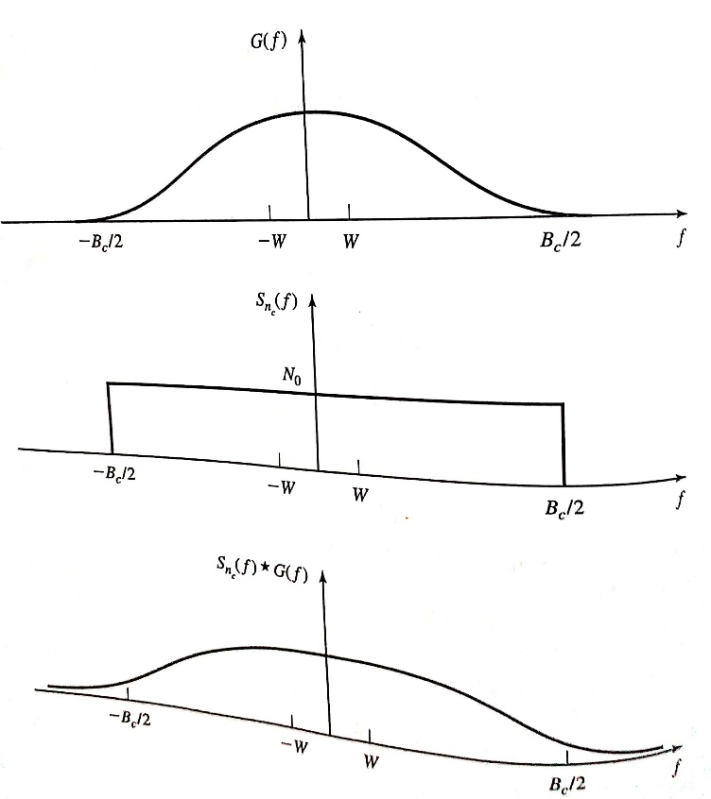
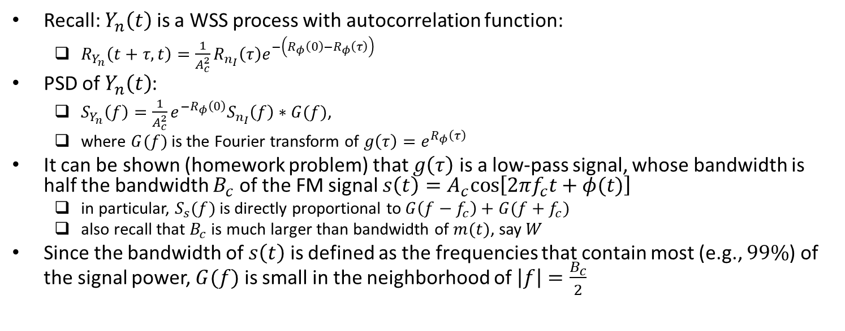
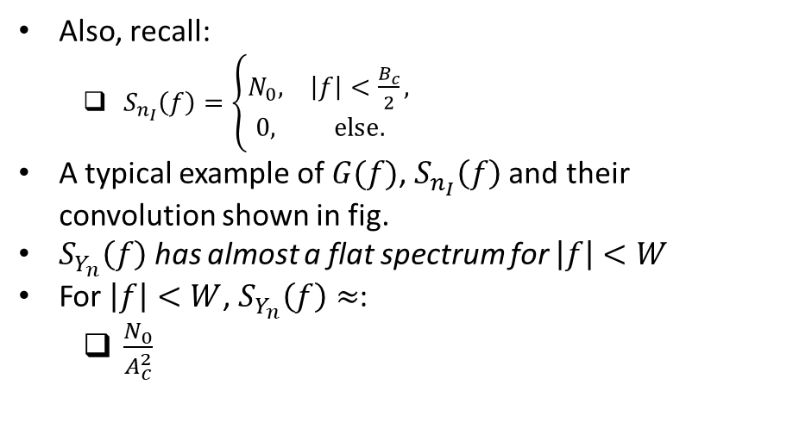
Effect of Noise on FM System (contd.)
Recall: $Y_{n}\left(t\right)$ is a WSS process with autocorrelation function:
$R_{Y_{n}}\left(t+τ,t\right)=\frac{1}{A_{c}^{2}}R_{n_{I}}\left(τ\right)e^{−\left(R_{φ}\left(0\right)−R_{φ}\left(τ\right)\right)}$
PSD of $Y_{n}\left(t\right)$:
$S_{Y_{n}}\left(f\right)=\frac{1}{A_{c}^{2}}e^{−R_{φ}\left(0\right)}S_{n_{I}}\left(f\right)∗G(f)$,
where $G(f)$ is the Fourier transform of $g\left(τ\right)=e^{R_{φ}\left(τ\right)}$
It can be shown (homework problem) that $g\left(τ\right)$ is a low-pass signal, whose bandwidth is half the bandwidth $B_{c}$ of the FM signal $s\left(t\right)=A_{c}cos\left[2πf_{c}t+φ(t)\right]$
in particular, $S_{s}(f)$ is directly proportional to $G\left(f−f_{c}\right)+G(f+f_{c})$
also recall that $B_{c}$ is much larger than bandwidth of $m(t)$, say $W$
Since the bandwidth of $s\left(t\right)$ is defined as the frequencies that contain most (e.g., $99\%$) of the signal power, $G(f)$ is small in the neighborhood of $\left|f\right|=\frac{B_{c}}{2}$
Also, recall:
$S_{n_{I}}\left(f\right)=\left\{\begin{matrix}N_{0}, & \left|f\right|<\frac{B_{c}}{2}, \\ 0, & else.\end{matrix}\right.$
A typical example of $G(f)$, $S_{n_{I}}\left(f\right)$ and their convolution shown in fig.
$S_{Y_{n}}\left(f\right)$ has almost a flat spectrum for $\left|f\right|<W$
For $\left|f\right|<W$, $S_{Y_{n}}\left(f\right)≈$:
$\frac{N_{0}}{A_{c}^{2}}$
Ref: “Communication Systems Engineering” by Proakis and Salehi

Slide 18
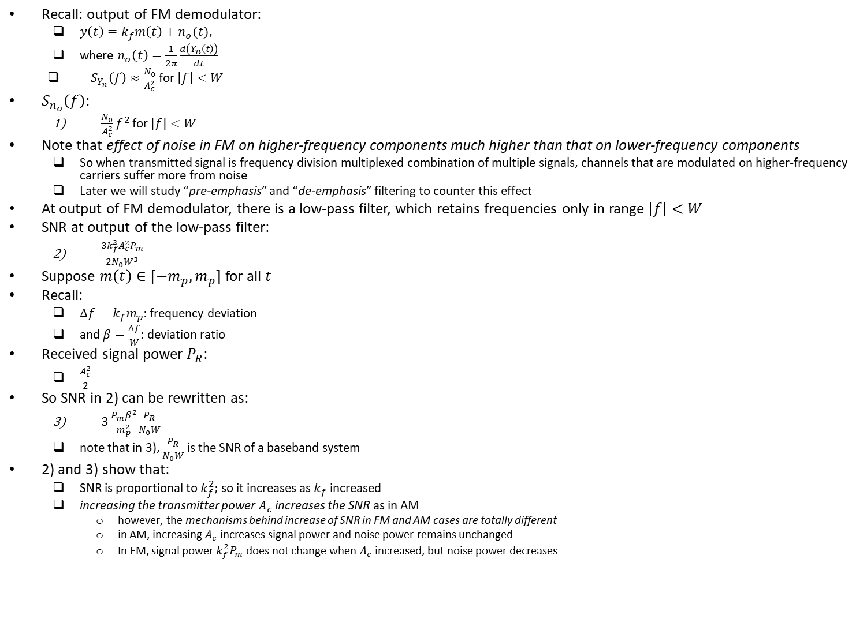
Effect of Noise on FM System (contd.)
Recall: output of FM demodulator:
$y\left(t\right)=k_{f}m\left(t\right)+n_{o}(t)$,
where $n_{o}\left(t\right)=\frac{1}{2π}\frac{d\left(Y_{n}\left(t\right)\right)}{dt}$
$S_{Y_{n}}\left(f\right)≈\frac{N_{0}}{A_{c}^{2}}$ for $\left|f\right|<W$
$S_{n_{o}}\left(f\right)$:
$\frac{N_{0}}{A_{c}^{2}}f^{2}$ for $\left|f\right|<W$
Note that effect of noise in FM on higher-frequency components much higher than that on lower-frequency components
So when transmitted signal is frequency division multiplexed combination of multiple signals, channels that are modulated on higher-frequency carriers suffer more from noise
Later we will study “pre-emphasis” and “de-emphasis” filtering to counter this effect
At output of FM demodulator, there is a low-pass filter, which retains frequencies only in range $\left|f\right|<W$
SNR at output of the low-pass filter:
$\frac{3k_{f}^{2}A_{c}^{2}P_{m}}{2N_{0}W^{3}}$
Suppose $m\left(t\right)∈[−m_{p},m_{p}]$ for all $t$
Recall:
$∆f=k_{f}m_{p}$: frequency deviation
and $β=\frac{∆f}{W}$: deviation ratio
Received signal power $P_{R}$:
$\frac{A_{c}^{2}}{2}$
So SNR in 2) can be rewritten as:
$3\frac{P_{m}β^{2}}{m_{p}^{2}}\frac{P_{R}}{N_{0}W}$
note that in 3), $\frac{P_{R}}{N_{0}W}$ is the SNR of a baseband system
2) and 3) show that:
SNR is proportional to $k_{f}^{2}$; so it increases as $k_{f}$ increased
increasing the transmitter power $A_{c}$ increases the SNR as in AM
however, the mechanisms behind increase of SNR in FM and AM cases are totally different
in AM, increasing $A_{c}$ increases signal power and noise power remains unchanged
In FM, signal power $k_{f}^{2}P_{m}$ does not change when $A_{c}$ increased, but noise power decreases

Slide 19
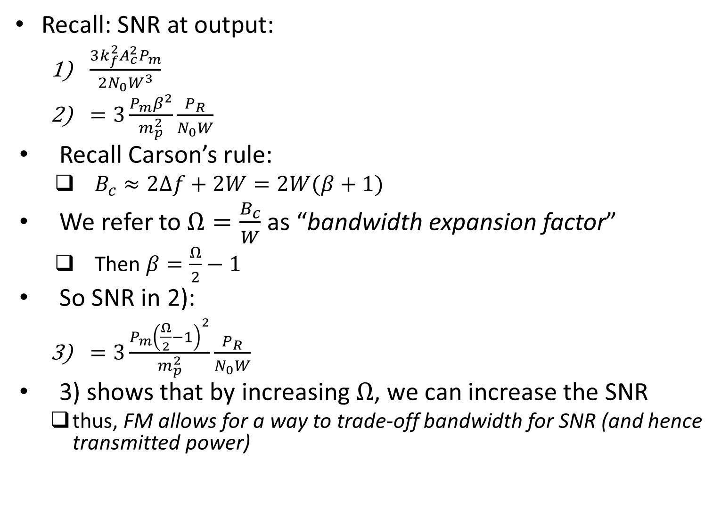
Effect of Noise on FM System (contd.)
Recall: SNR at output:
$\frac{3k_{f}^{2}A_{c}^{2}P_{m}}{2N_{0}W^{3}}$
$=3\frac{P_{m}β^{2}}{m_{p}^{2}}\frac{P_{R}}{N_{0}W}$
Recall Carson’s rule:
$B_{c}≈2∆f+2W=2W(β+1)$
We refer to $Ω=\frac{B_{c}}{W}$ as “bandwidth expansion factor”
Then $β=\frac{Ω}{2}−1$
So SNR in 2):
$=3\frac{P_{m}{\left(\frac{Ω}{2}−1\right)}^{2}}{m_{p}^{2}}\frac{P_{R}}{N_{0}W}$
3) shows that by increasing $Ω$, we can increase the SNR
thus, FM allows for a way to trade-off bandwidth for SNR (and hence transmitted power)

Slide 20
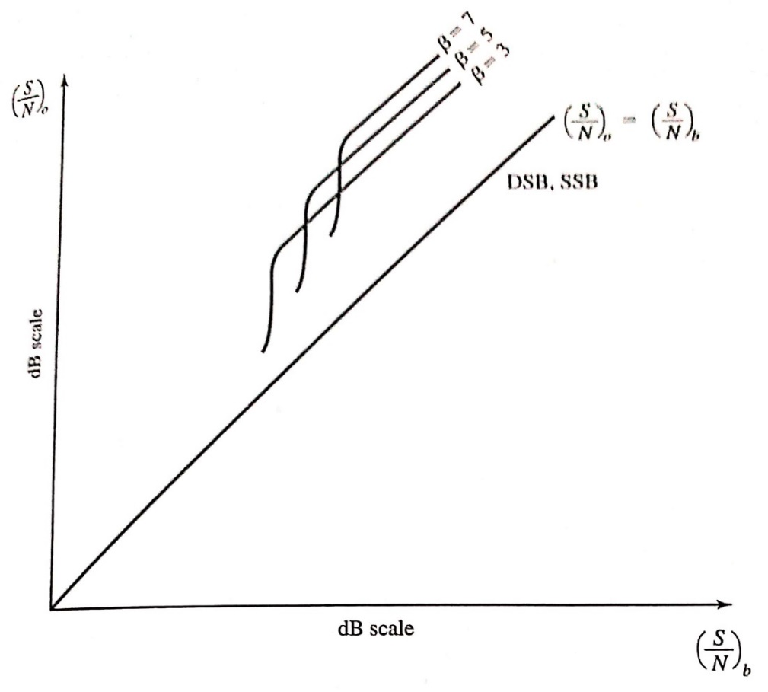
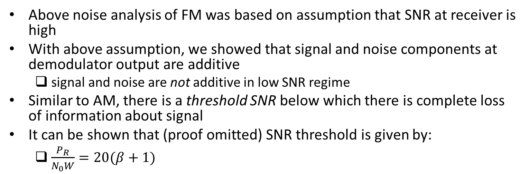
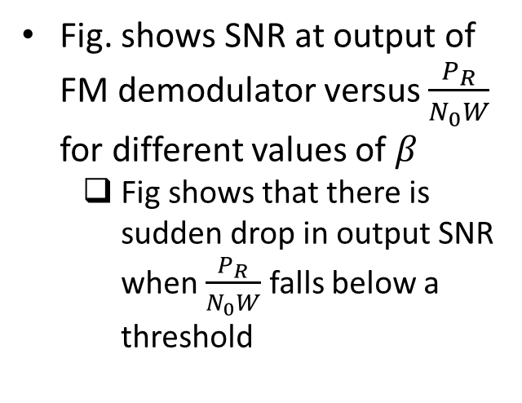
Threshold Effect in FM
Above noise analysis of FM was based on assumption that SNR at receiver is high
With above assumption, we showed that signal and noise components at demodulator output are additive
signal and noise are not additive in low SNR regime
Similar to AM, there is a threshold SNR below which there is complete loss of information about signal
It can be shown that (proof omitted) SNR threshold is given by:
$\frac{P_{R}}{N_{0}W}=20(β+1)$
Fig. shows SNR at output of FM demodulator versus $\frac{P_{R}}{N_{0}W}$ for different values of $β$
Fig shows that there is sudden drop in output SNR when $\frac{P_{R}}{N_{0}W}$ falls below a threshold
Ref: “Communication Systems Engineering” by Proakis and Salehi

Slide 21
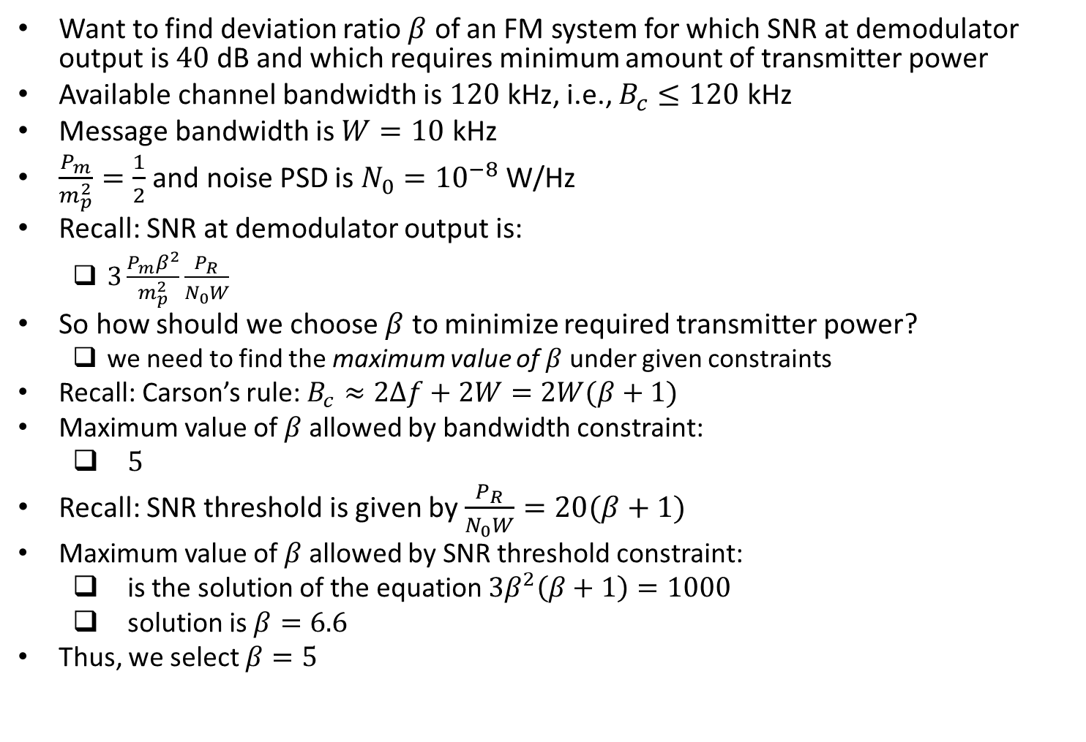
Example
Want to find deviation ratio $β$ of an FM system for which SNR at demodulator output is $40$ dB and which requires minimum amount of transmitter power
Available channel bandwidth is $120$ kHz, i.e., $B_{c}≤120$ kHz
Message bandwidth is $W=10$ kHz
$\frac{P_{m}}{m_{p}^{2}}=\frac{1}{2}$ and noise PSD is $N_{0}={10}^{−8}$ W/Hz
Recall: SNR at demodulator output is:
$3\frac{P_{m}β^{2}}{m_{p}^{2}}\frac{P_{R}}{N_{0}W}$
So how should we choose $β$ to minimize required transmitter power?
we need to find the maximum value of $β$ under given constraints
Recall: Carson’s rule: $B_{c}≈2∆f+2W=2W(β+1)$
Maximum value of $β$ allowed by bandwidth constraint:
$5$
Recall: SNR threshold is given by $\frac{P_{R}}{N_{0}W}=20(β+1)$
Maximum value of $β$ allowed by SNR threshold constraint:
is the solution of the equation $3β^{2}\left(β+1\right)=1000$
solution is $β=6.6$
Thus, we select $β=5$

Slide 22
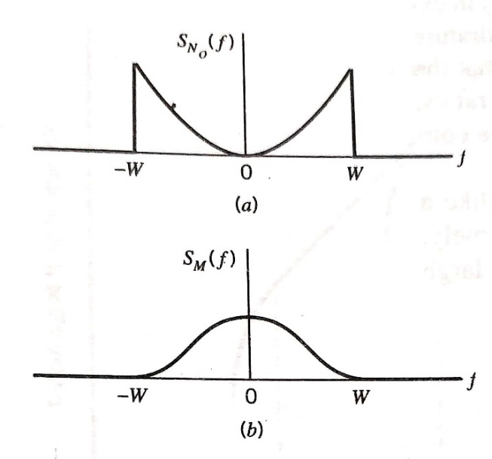
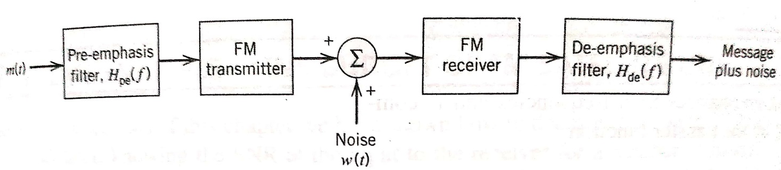
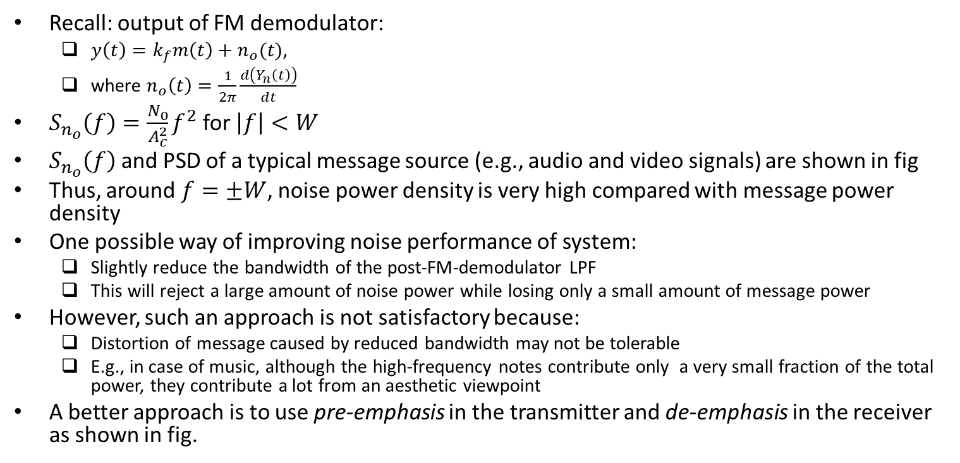
Pre-Emphasis and De-Emphasis in FM
Recall: output of FM demodulator:
$y\left(t\right)=k_{f}m\left(t\right)+n_{o}(t)$,
where $n_{o}\left(t\right)=\frac{1}{2π}\frac{d\left(Y_{n}\left(t\right)\right)}{dt}$
$S_{n_{o}}\left(f\right)=\frac{N_{0}}{A_{c}^{2}}f^{2}$ for $\left|f\right|<W$
$S_{n_{o}}\left(f\right)$ and PSD of a typical message source (e.g., audio and video signals) are shown in fig
Thus, around $f=±W$, noise power density is very high compared with message power density
One possible way of improving noise performance of system:
Slightly reduce the bandwidth of the post-FM-demodulator LPF
This will reject a large amount of noise power while losing only a small amount of message power
However, such an approach is not satisfactory because:
Distortion of message caused by reduced bandwidth may not be tolerable
E.g., in case of music, although the high-frequency notes contribute only a very small fraction of the total power, they contribute a lot from an aesthetic viewpoint
A better approach is to use pre-emphasis in the transmitter and de-emphasis in the receiver as shown in fig.
Ref: “Communication Systems” by Haykin and Moher

Slide 23
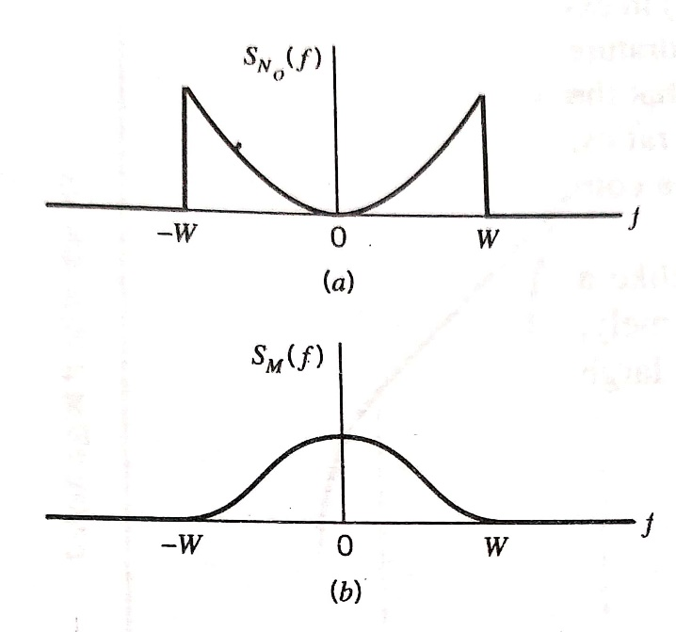
Pre-Emphasis and De-Emphasis in FM (contd.)
In pre-emphasis and de-emphasis approach, we:
artificially emphasize the high-frequency components of the message signal prior to modulation in transmitter
at the demodulator output, we perform inverse operation by de-emphasizing high-frequency components so as to restore original signal-power distribution of message
High-frequency components of the noise at the demodulator output are also reduced, thereby effectively increasing output SNR of system
Ref: “Communication Systems” by Haykin and Moher

Slide 24
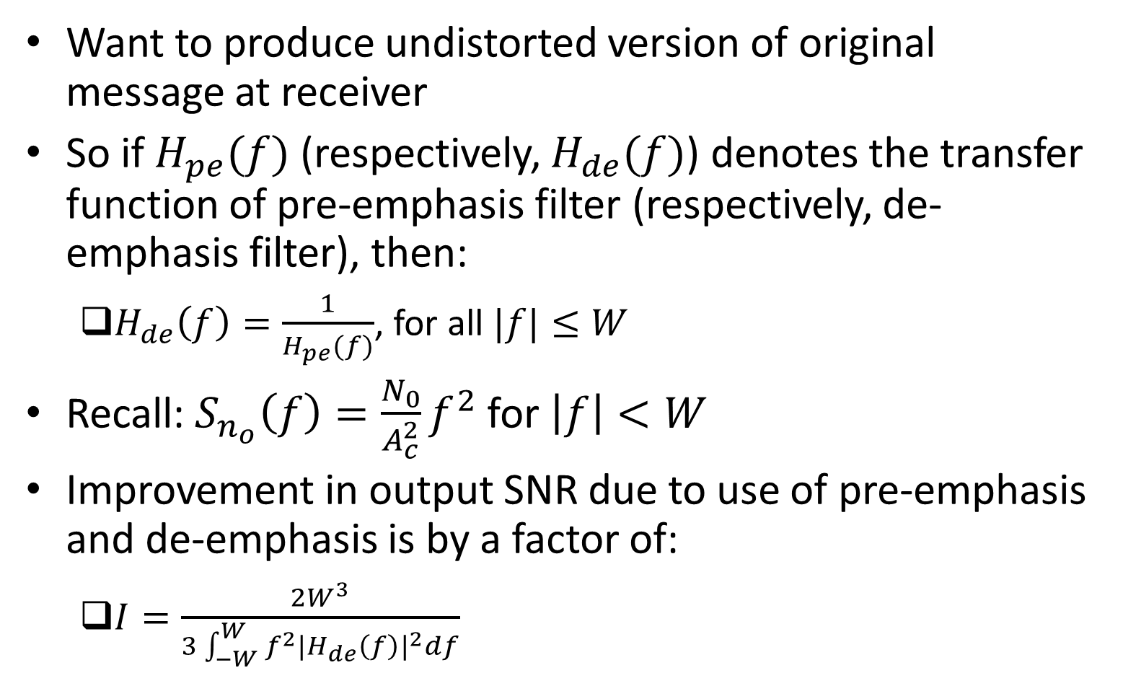
Pre-Emphasis and De-Emphasis in FM (contd.)
Want to produce undistorted version of original message at receiver
So if $H_{pe}(f)$ (respectively, $H_{de}(f)$) denotes the transfer function of pre-emphasis filter (respectively, de-emphasis filter), then:
$H_{de}\left(f\right)=\frac{1}{H_{pe}(f)}$, for all $|f|≤W$
Recall: $S_{n_{o}}\left(f\right)=\frac{N_{0}}{A_{c}^{2}}f^{2}$ for $\left|f\right|<W$
Improvement in output SNR due to use of pre-emphasis and de-emphasis is by a factor of:
$I=\frac{2W^{3}}{3\int_{−W}^{W}{f^{2}{|H_{de}\left(f\right)|}^{2}}df}$

Slide 25
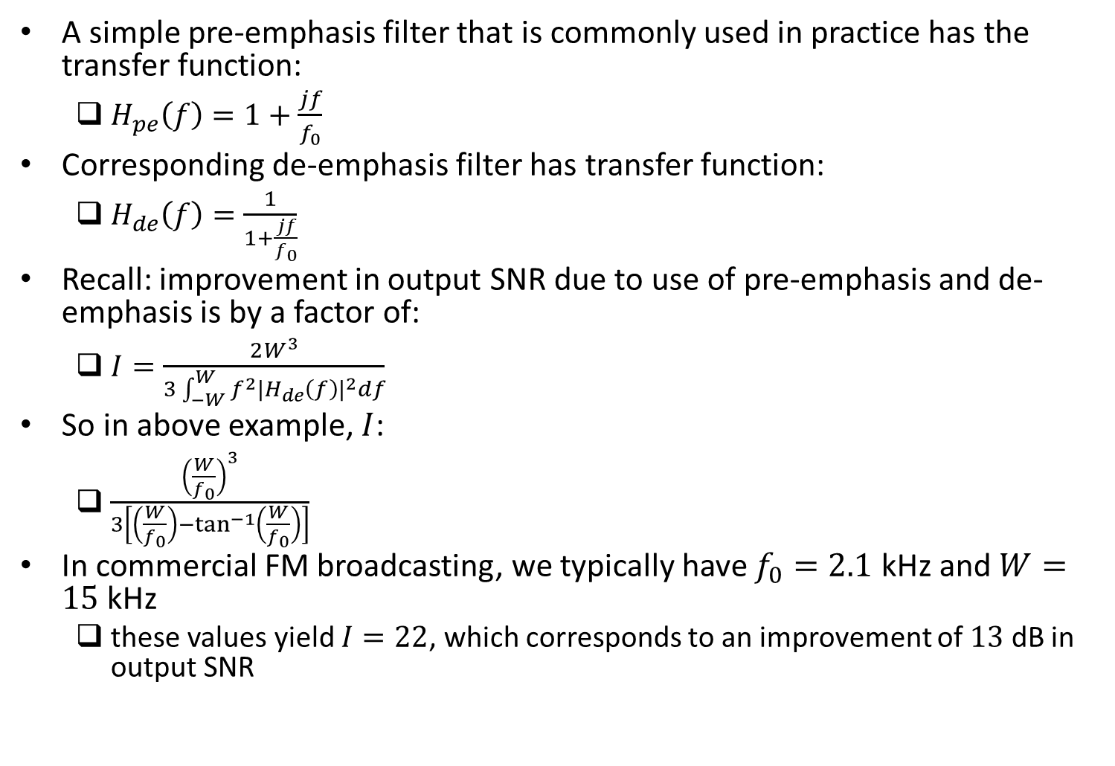
Example
A simple pre-emphasis filter that is commonly used in practice has the transfer function:
$H_{pe}\left(f\right)=1+\frac{jf}{f_{0}}$
Corresponding de-emphasis filter has transfer function:
$H_{de}\left(f\right)=\frac{1}{1+\frac{jf}{f_{0}}}$
Recall: improvement in output SNR due to use of pre-emphasis and de-emphasis is by a factor of:
$I=\frac{2W^{3}}{3\int_{−W}^{W}{f^{2}{|H_{de}\left(f\right)|}^{2}}df}$
So in above example, $I$:
$\frac{{\left(\frac{W}{f_{0}}\right)}^{3}}{3\left[\left(\frac{W}{f_{0}}\right)−\tan^{−1}\left(\frac{W}{f_{0}}\right)\right]}$
In commercial FM broadcasting, we typically have $f_{0}=2.1$ kHz and $W=15$ kHz
these values yield $I=22$, which corresponds to an improvement of $13$ dB in output SNR

